Slide 1
CS383 - Enterprise Web Application Development
Module 1: Bootstrap
Part 02

Slide 2
Content
Containers
Responsive breakpoints
Grid System

Slide 3
Containers
The basic layout elements
Required when using the default Grid system
Can be:
Responsive Fixed-width
Fluid-width
Can be nested

Slide 4
Containers
Responsive Fixed-width
<div class="container">
<!-- Content here -->
</div>

Slide 5
Containers
Fluid-width
<div class="container-fluid">
<!-- Content here -->
</div>

Slide 6
Responsive breakpoints
based on minimum viewport widths
allow us to scale up elements as the viewport changes
Viewport | size | width | Media query | E.g.
Extra small | xs | < 576px | Default
Small | sm | > 576px | @media (min-width: 576px) | landscape phones
Medium | md | > 768px | @media (min-width: 768px) | Tablets
Large | lg | > 992px | @media (min-width: 992px) | Desktops
Extra large | xl | > 1200px | @media (min-width: 1200px) | large desktops

Slide 7
Grid System
Used for content alignment and layout
Built using flexbox
Fully responsive
Contains:
Container(s)
Row(s)
Column(s)

Slide 8
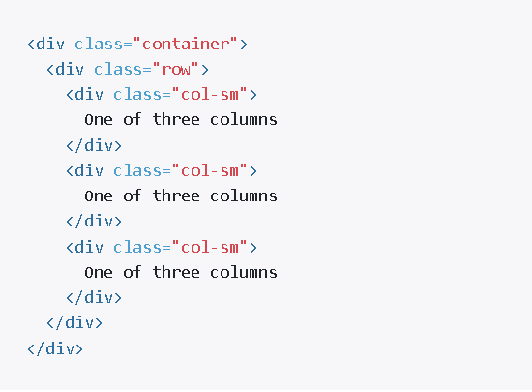
Grid System
Example:

Slide 9
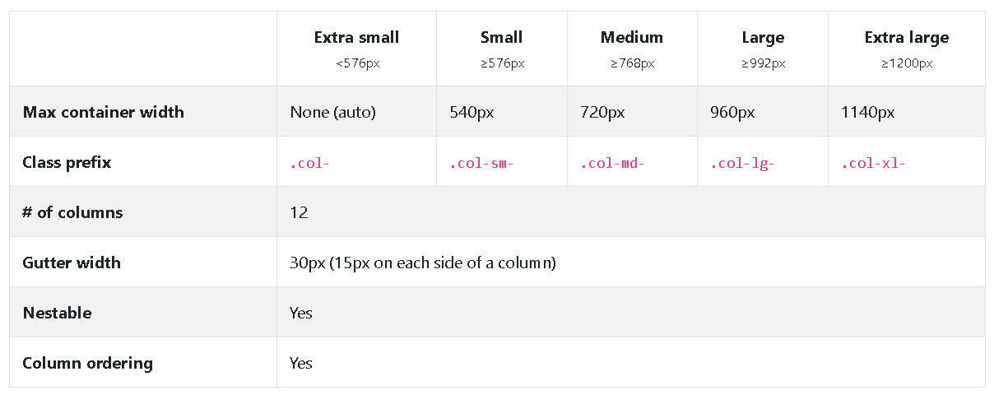
Grid options

Slide 10
Notes / Recommendations
Full tutorial on Grid System with examples on: https://www.tutorialspoint.com/bootstrap/bootstrap_grid_system.htm
Offline copy of bootstrap/docs/Examples: https://getbootstrap.com/docs/4.0/examples/

